Slide 1
Determining Visibility

Slide 2
What is visibility?
Visibility is the ability of one object to “see” or have reference to another
To send a message from one object to another, the receiver object must be “visible” to the sender, via a reference

Slide 3
When is visibility necessary?
To send a message from one object to another, the receiver object must be visible to the sender, so the sender has to have a pointer or reference to the receiver.

Slide 4

Visibility between Objects
For a Sender Object to send message to a receiver object, the sender must be visible to the receiver or sender must have some kind of reference or pointer to the receiver object
Class Register{
……
private ProductCatalog catalog;
……
}
:Register
:ProductCatalog
enterITem(itemID,quantity)
spec:=getSpecification(itemID)
When creating a design of interacting objects, it is necessary to ensure that visibility to present to support the message interaction

Slide 5
Visibility - Types
Four common ways that visibility can be achieved from Object A to Object B.
  Attribute Visibility - B is an Attribute of A.
  Parameter Visibility - B is a parameter of a method of A.
  Local Visibility - B is a (non-parameter) a local object in a method of A.
  Global Visibility - B is in some way globally visible.
Motivation to consider visibility is
“For an object A to send a message to object B, B must be visible to A”
For example, to create an interaction diagram in which the message is sent from a Register instance to a ProductCatalog instance, the Register must be visible to ProductCatalog
A typical visibility solution is that a reference to the ProductCatalog instance is maintained as a attribute of the Register

Slide 6
Attribute Visibility
Attribute visibility from A to B exists if
  B is an attribute of A
It is relatively permanent visibility because it persists as long as A & B exists.
Very common of visibility in OO systems.
For example: In NextPOS system, a Register instance may have attribute visibility to a ProductCatalog, since it is an attribute of Register.

Slide 7

Attribute Visibility
public class Register{
…
private ProductCatalog catalog;
…
}
Class Register{
……
private ProductCatalog catalog;
……
}
{
{ ……
public void enterItem(itemID, qty)
{
spec:=catalog.getSpecification(itemID);
}
}
:Register
:ProductCatalog
enterITem(itemID,quantity)
spec:=getSpecification(itemID)

Slide 8
Parameter Visibility
Parameter visibility from A to B exists when B is passed as a parameter to the method of A
It is relatively temporary visibility because it persists only within the scope of the method
After attribute visibility, it is the second most common visibility.
To illustrate, when makeLineItem message is sent to a Sale instance, a ProductDescription instance is passed as a parameter
Within the scope of the makeLineItem method, the Sale has parameter visibility to ProductDescription
It is common to transform parameter visibility into attribute visibility.

Slide 9
Parameter Visibility
Within the scope of the makeLineItem method, the sale has parameter visibility to ProdutSpecification
enterItem(id,qty)
2:makeLineItem(spec,qty)
:Register
:Sale
1:spec:=getSpecification(id)
:ProductCatalog
sl:SaleLineItem
{
{ ……
makeLineItem(ProductSpecification spec, int qty)
{
sl = new saleLineItem(spec,qty);
}
}

Slide 10

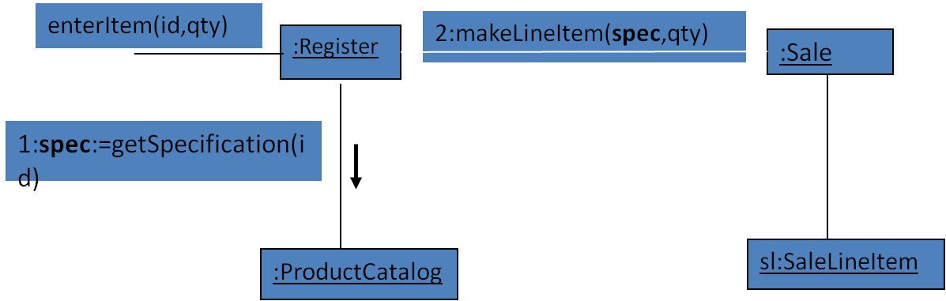
Conversion -Parameter to Attribute Visibility
It is common to transform parameter visibility into attribute visibility.
For example, when the Sale creates a new SalesLineItem, it passes a
ProductSpecification in to its initializing method (in C++ or Java, this would
be its constructor).
Within the initializing method, the parameter is assigned to an attribute, thus establishing attribute visibility
2.1:create(spec,qty)
{ //initializing method ..java constructor
{ ……
saleLineItemProductSpecification spec, int qty){
productSpec = spec; //parameter to attribute visibility
}
}

Slide 11
Local Visibility
Local visibility between A to B exists when B is declared as a local object within a method of A
It is relatively temporary visibility because it persists only within the scope of the method
It is the third most common visibility
Two common means by which local visibility is achieved
Create a new local instance & assign it to a local variable
Assign the returning object from the method invocation to a local variable shown in figure below.
As with parameter visibility, it is common to transform locally declared visibility to into attribute visibility.

Slide 12
Local Visibility
enterItem(id,qty)
……
//local visibility via assignment of returning object
ProductSpecification spec=catalog.getSpecification(id)
……
}
:Register
:ProductCatalog
enterITem(itemID,quantity)
spec:=getSpecification(itemID)

Slide 13
Global Visibility
Global visibility from A to B exists when B is global to A.
It is relatively permanent visibility because is persists as long as A & B exists.
It is the least common form of visibility in OO systems.
One way to achieve global visibility is to assign an instance to a global variable –possible in C++ but not in Java
Another way is to use singleton pattern

Slide 14

Singleton design pattern
Ensure that a class has only one instance and provide
a global point of access to it

Slide 15
Questions for discussion
Q. Which would you use if you wanted a relatively permanent connection between sender & receiver objects?
A. attribute, or global
Q. Which would you use if you didn't want a permanent connection?
A. parameter, or local
Q. How would you achieve global visibility?
A. use a global variable in C++,
static (or class) variable (in C++ or Java) or the Singleton pattern (a static method that returns the object)

Slide 16
Visibility in the UML
Public:
  Any outside classifier with visibility to the given classifier can use the feature; specified by pre-pending the symbol “+”
Protected:
  Any descendant of the classifier can use the feature; specified by pre-pending the symbol “#”
Private:
  Only the classifier itself can use the feature; specified by pre-pending the symbol “-”

